Slide 1

Likelihood Ratio Test
Nina Gunnes
May 6, 2021

Slide 2
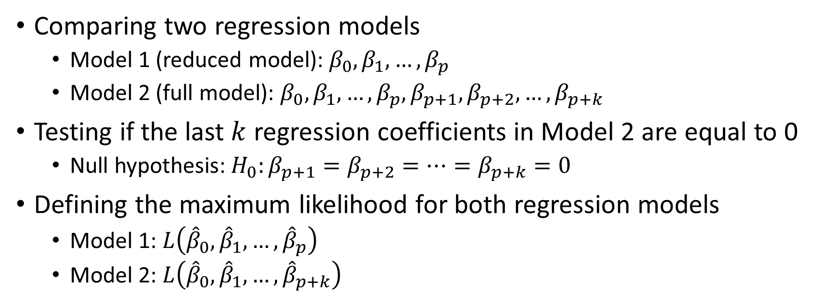
Likelihood ratio test
Comparing two regression models
  Model 1 (reduced model): $β_{0},β_{1},…,β_{p}$
  Model 2 (full model): $β_{0},β_{1},…,β_{p},β_{p+1},β_{p+2},…,β_{p+k}$
Testing if the last $k$ regression coefficients in Model 2 are equal to 0
  Null hypothesis: $H_{0}:β_{p+1}=β_{p+2}=…=β_{p+k}=0$
Defining the maximum likelihood for both regression models
  Model 1: $L\left({\hat{β}}_{0},{\hat{β}}_{1},…,{\hat{β}}_{p}\right)$
  Model 2: $L\left({\hat{β}}_{0},{\hat{β}}_{1},…,{\hat{β}}_{p+k}\right)$

Slide 3
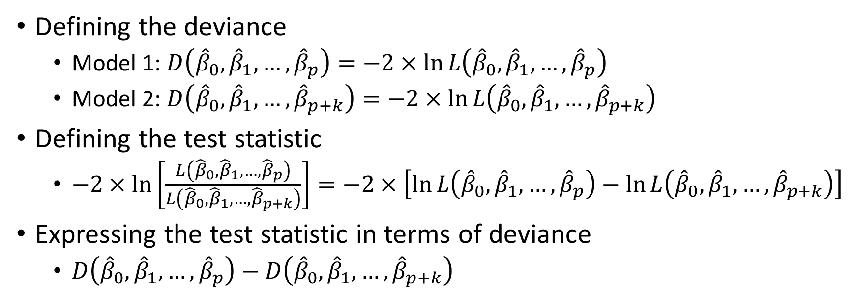
Likelihood ratio test, cont.
Defining the deviance
  Model 1: $D\left({\hat{β}}_{0},{\hat{β}}_{1},…,{\hat{β}}_{p}\right)=−2×\ln{L\left({\hat{β}}_{0},{\hat{β}}_{1},…,{\hat{β}}_{p}\right)}$
  Model 2: $D\left({\hat{β}}_{0},{\hat{β}}_{1},…,{\hat{β}}_{p+k}\right)=−2×\ln{L\left({\hat{β}}_{0},{\hat{β}}_{1},…,{\hat{β}}_{p+k}\right)}$
Defining the test statistic
  $−2×\ln\left[\frac{L\left({\hat{β}}_{0},{\hat{β}}_{1},…,{\hat{β}}_{p}\right)}{L\left({\hat{β}}_{0},{\hat{β}}_{1},…,{\hat{β}}_{p+k}\right)}\right]=−2×\left[\ln{L\left({\hat{β}}_{0},{\hat{β}}_{1},…,{\hat{β}}_{p}\right)}−\ln{L\left({\hat{β}}_{0},{\hat{β}}_{1},…,{\hat{β}}_{p+k}\right)}\right]$
Expressing the test statistic in terms of deviance
  $D\left({\hat{β}}_{0},{\hat{β}}_{1},…,{\hat{β}}_{p}\right)−D\left({\hat{β}}_{0},{\hat{β}}_{1},…,{\hat{β}}_{p+k}\right)$

Slide 4
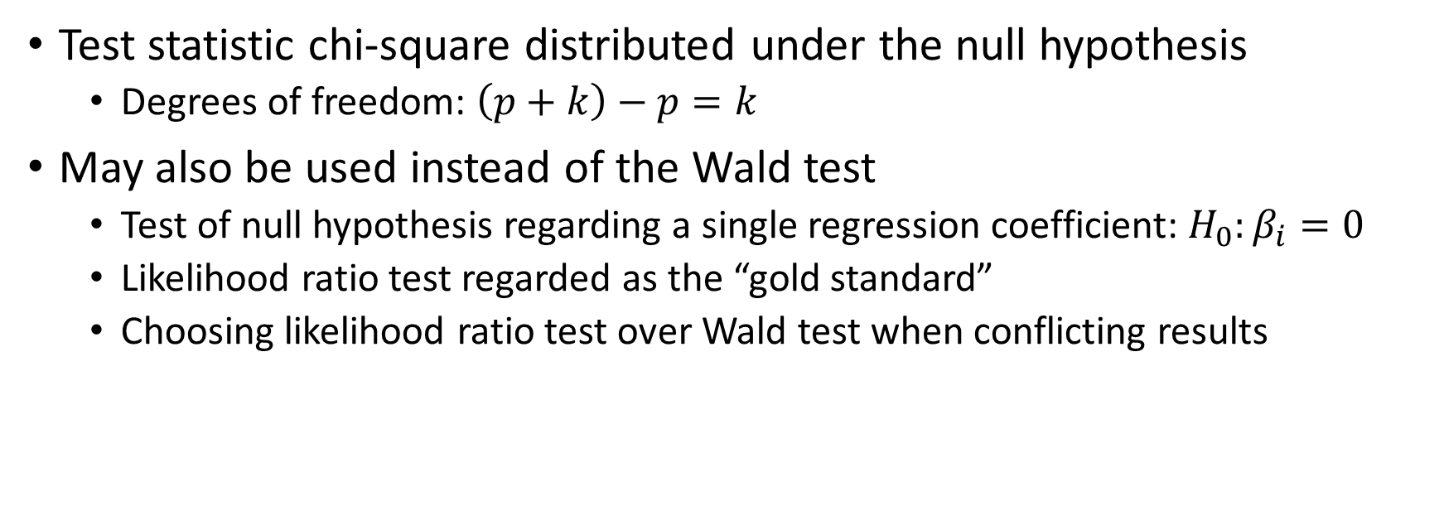
Likelihood ratio test, cont.
Test statistic chi-square distributed under the null hypothesis
  Degrees of freedom: $\left(p+k\right)−p=k$
May also be used instead of the Wald test
  Test of null hypothesis regarding a single regression coefficient: $H_{0}:β_{i}=0$
  Likelihood ratio test regarded as the “gold standard”
  Choosing likelihood ratio test over Wald test when conflicting results

Slide 5
Example 3.10 in Laake et al. (2007)
Women’s Lifestyle and Health Cohort Study (Veierød et al., 2003)
  Norwegian-Swedish study on risk factors for malignant melanoma
  Part of the Norwegian Women and Cancer (NOWAC) Study
Women aged 30–50 years
Follow-up from 1991/1992 through 1999
Women followed to the first-occurring event after inclusion
  Diagnosis of malignant melanoma
  Censoring (emigration, death, or end of study on December 31, 1999)

Slide 6
Example 3.10 in Laake et al. (2007), cont.
Including 106,379 women
  187 cases of malignant melanoma
Hair color as an important risk factor for malignant melanoma
Hair color represented by three dummy variables
  dark brown or black
  brown
  blond
  red

Slide 7
Example 3.10 in Laake et al. (2007), cont.
Using Poisson regression to model incidence rate by hair color
  Adjustment for attained age (categorical variable)
  Adjustment for place of residence (categorical variable)
Attained age represented by three dummy variables
  30–40 years
  41–45 years
  46–50 years
  51–60 years

Slide 8
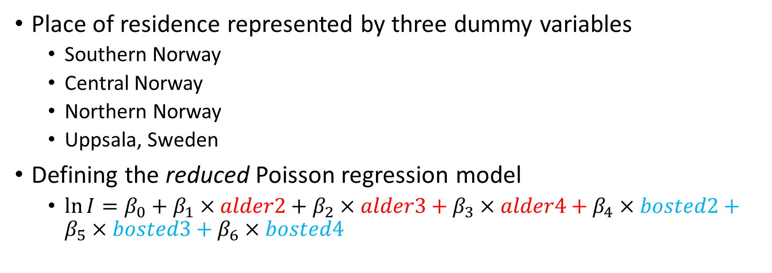
Example 3.10 in Laake et al. (2007), cont.
Place of residence represented by three dummy variables
  Southern Norway
  Central Norway
  Northern Norway
  Uppsala, Sweden
Defining the reduced Poisson regression model
  $\ln{I}=β_{0}+β_{1}×alder2+β_{2}×alder3+β_{3}×alder4+β_{4}×bosted2+β_{5}×bosted3+β_{6}×bosted4$

Slide 9
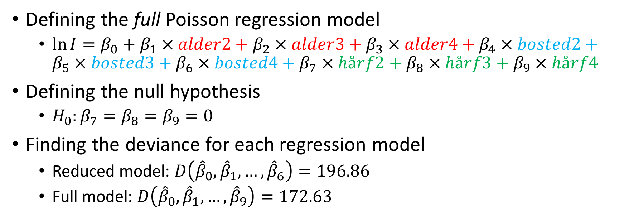
Example 3.10 in Laake et al. (2007), cont.
Defining the full Poisson regression model
  $\ln{I}=β_{0}+β_{1}×alder2+β_{2}×alder3+β_{3}×alder4+β_{4}×bosted2+β_{5}×bosted3+β_{6}×bosted4+β_{7}×hårf2+β_{8}×hårf3+β_{9}×hårf4$
Defining the null hypothesis
  $H_{0}:β_{7}=β_{8}=β_{9}=0$
Finding the deviance for each regression model
  Reduced model: $D\left({\hat{β}}_{0},{\hat{β}}_{1},…,{\hat{β}}_{6}\right)=196.86$
  Full model: $D\left({\hat{β}}_{0},{\hat{β}}_{1},…,{\hat{β}}_{9}\right)=172.63$

Slide 10
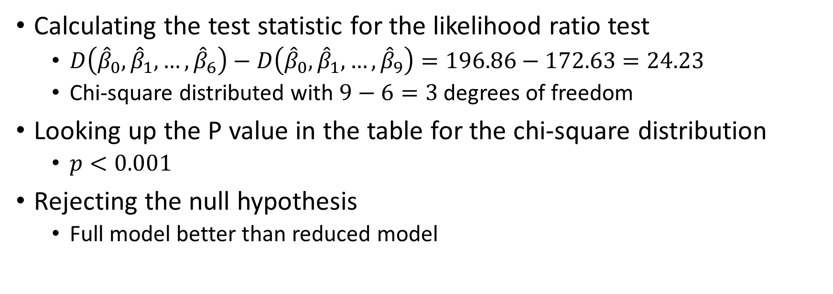
Example 3.10 in Laake et al. (2007), cont.
Calculating the test statistic for the likelihood ratio test
  $D\left({\hat{β}}_{0},{\hat{β}}_{1},…,{\hat{β}}_{6}\right)−D\left({\hat{β}}_{0},{\hat{β}}_{1},…,{\hat{β}}_{9}\right)=196.86−172.63=24.23$
  Chi-square distributed with $9−6=3$ degrees of freedom
Looking up the P value in the table for the chi-square distribution
  $p<0.001$
Rejecting the null hypothesis
  Full model better than reduced model

Slide 11
How to do it in Stata
Stata Base Reference Manual, Release 15
  Example 1 on page 1402 (“Likelihood-ratio test after estimation” section)
Data on newborns with low birth weight and maternal characteristics
  Hosmer, Lemeshow, and Sturdivant (2013)
Observations of 189 newborns
Low birth weight as a dichotomous outcome
  Birth weight ≥ 2,500 g (130 newborns)
  Birth weight < 2,500 g (59 newborns)

Slide 12
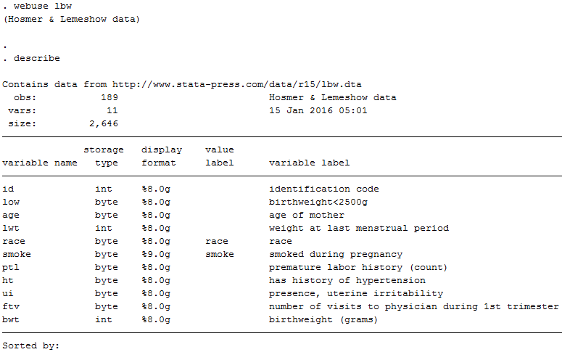
How to do it in Stata, cont.

Slide 13
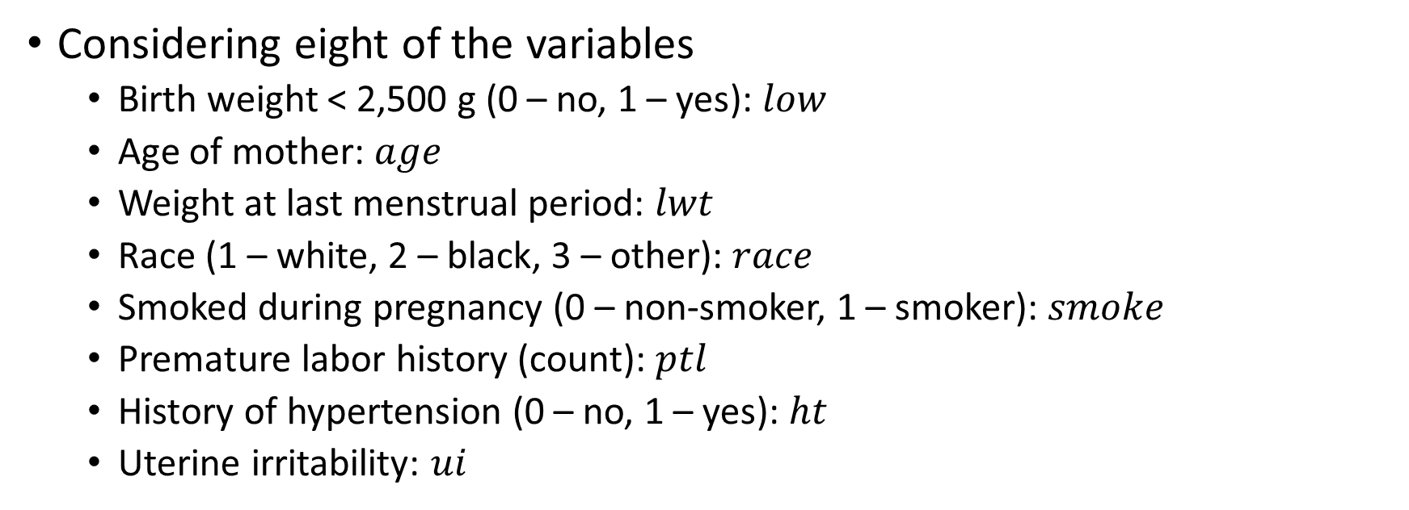
How to do it in Stata, cont.
Considering eight of the variables
  Birth weight < 2,500 g (0 – no, 1 – yes): $low$
  Age of mother: $age$
  Weight at last menstrual period: $lwt$
  Race (1 – white, 2 – black, 3 – other): $race$
  Smoked during pregnancy (0 – non-smoker, 1 – smoker): $smoke$
  Premature labor history (count): $ptl$
  History of hypertension (0 – no, 1 – yes): $ht$
  Uterine irritability: $ui$

Slide 14
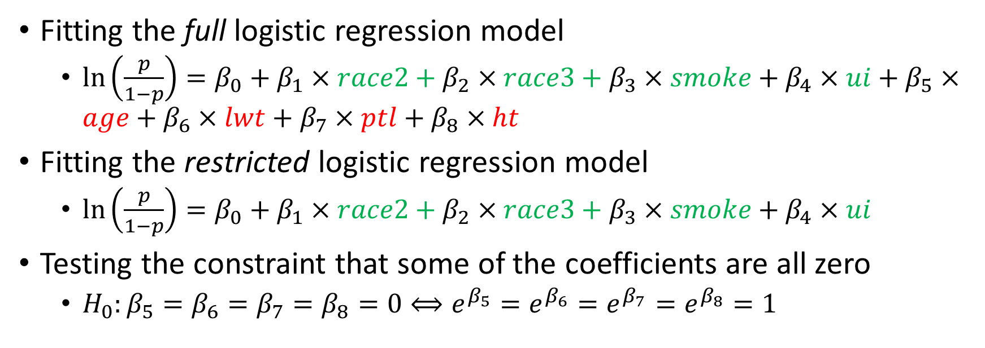
How to do it in Stata, cont.
Fitting the full logistic regression model
  $\ln\left(\frac{p}{1−p}\right)=β_{0}+β_{1}×race2+β_{2}×race3+β_{3}×smoke+β_{4}×ui+β_{5}×age+β_{6}×lwt+β_{7}×ptl+β_{8}×ht$
Fitting the restricted logistic regression model
  $\ln\left(\frac{p}{1−p}\right)=β_{0}+β_{1}×race2+β_{2}×race3+β_{3}×smoke+β_{4}×ui$
Testing the constraint that some of the coefficients are all zero
  $H_{0}:β_{5}=β_{6}=β_{7}=β_{8}=0⟺e^{β_{5}}=e^{β_{6}}=e^{β_{7}}=e^{β_{8}}=1$

Slide 15
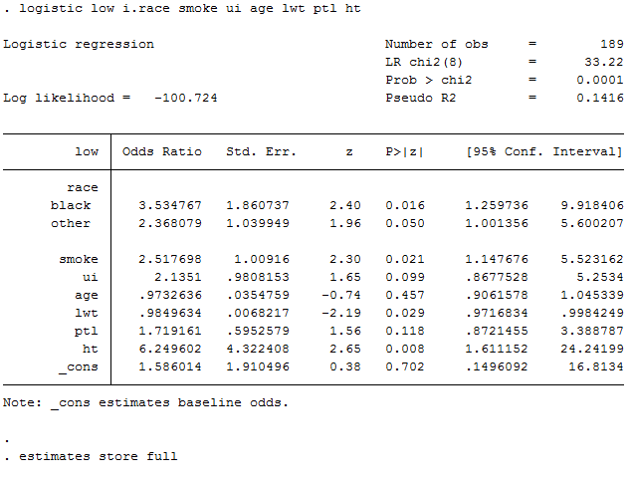
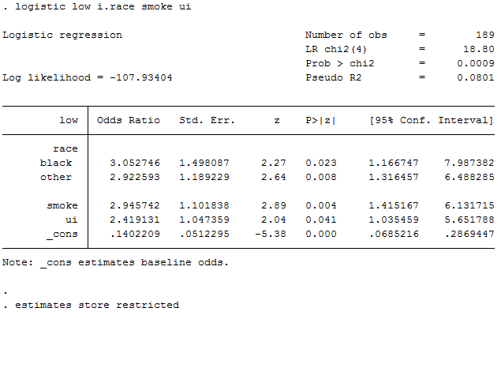
How to do it in Stata, cont.

Slide 16
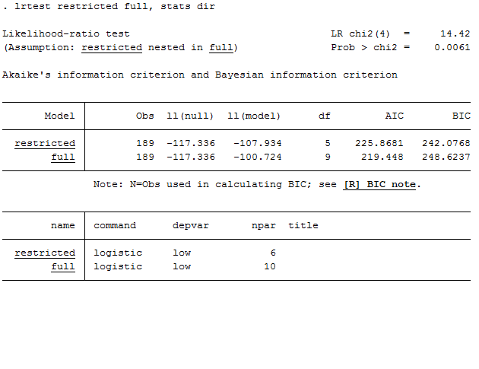
How to do it in Stata, cont.

Slide 17
References
Hosmer DW Jr, Lemeshow S, Sturdivant RX. Applied Logistic Regression. 3rd ed. Hoboken, NJ: Wiley; 2013.
Laake P, Hjartåker A, Thelle DS, Veierød MB. Epidemiologiske og kliniske forskningsmetoder. Oslo: Gyldendal akademisk; 2007. https://www.med.uio.no/imb/forskning/publikasjoner/boker/2007/epidemiolgiske-kliniske-forskningsmetoder.html.
StataCorp. 2017. Stata 15 Base Reference Manual. College Station, TX: Stata Press.

